Slide 1

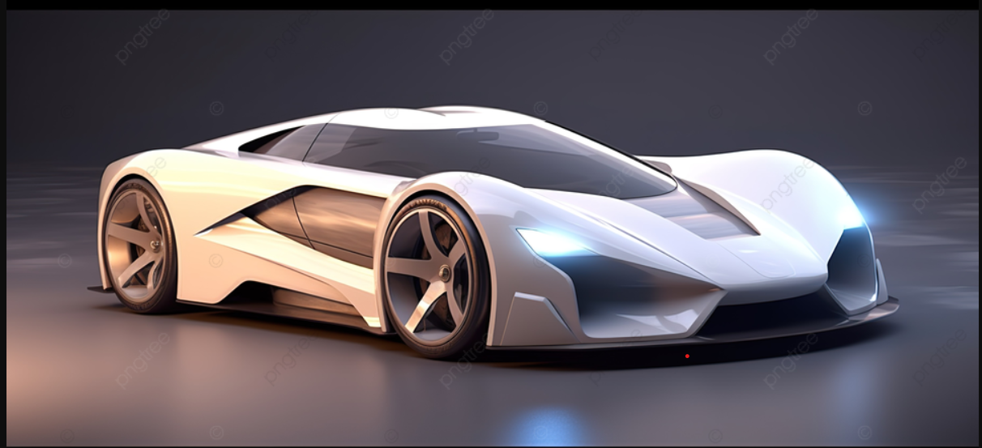
Car_Prediction Analysis
Power Bi Reinforcement Project
Sangeetha N
DA& DS
06-05-2025

Slide 2
Introduction:
The dataset offers comprehensive details on various cars, including attributes such as name, brand, engine type, and historical pricing data, designed to facilitate precise car price prediction by examining key features and pricing trends.
This dataset is meticulously curated to provide in-depth information on cars, encompassing attributes like name, brand, engine type, and historical pricing data, enabling accurate car price prediction through analysis of key features and trends.
The dataset contains extensive information on diverse cars, including name, brand, engine type, and historical pricing data, tailored to support accurate car price prediction by analyzing significant features and pricing patterns over time.

Slide 3
Data Information
Car ID – A unique identifier assigned to each car entry in the dataset.
Brand – The manufacturer or make of the car (e.g., Toyota, Ford).
Model – The specific name or series of the car produced by the brand.
Mileage – The total distance the car has traveled, typically measured in kilometers or miles.
Transmission – The type of gearbox system, such as manual or automatic.
Price – The selling price of the car at the time of sale.
Engine Size – The capacity of the car’s engine, usually in liters (L) or cubic centimeters (cc).
Fuel Type – The kind of fuel the car uses, such as petrol, diesel, electric, or hybrid.
Year – The year in which the car was sold or manufactured.
Condition – The overall state of the car, like new, used, or certified pre-owned.

Slide 4
Dax Function
Average _mileage = AVERAGE(car_price_prediction_[Mileage])
Average Car_Age = AVERAGE(car_price_prediction_[Car ID])
Average_engine size = AVERAGE(car_price_prediction_[Engine Size])
Average_price = AVERAGE(car_price_prediction_[Price])
Count_car = COUNT(car_price_prediction_[Brand])
Maximum_price = MAX(car_price_prediction_[Price])
Minimum Price = MIN(car_price_prediction_[Price])
Premium_Car = CALCULATE(COUNTROWS(car_price_prediction_),
car_price_prediction_[Condition]="New")
Total Amount = sum(car_price_prediction_[Price])
Brand & Model=car_price_prediction_[Brand]&"_"&car_price_prediction_[Model]

Slide 5
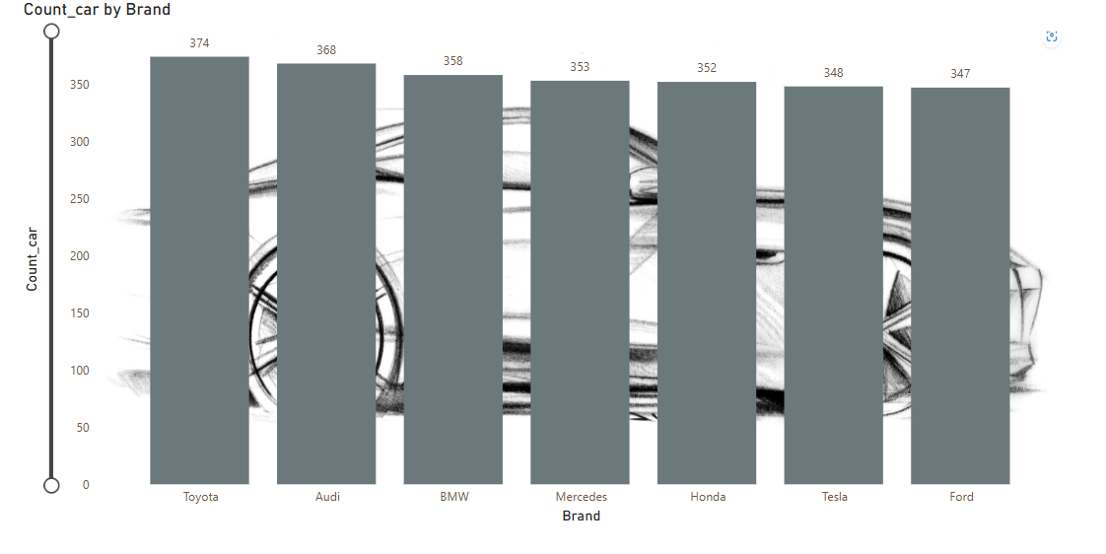
Chart In Count Wise Analysis

Slide 6
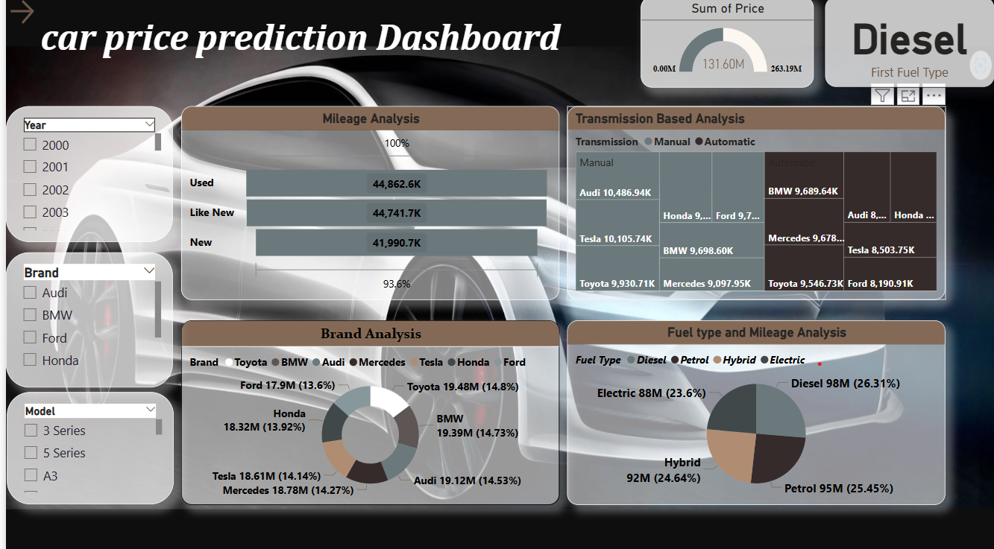
Dashboard

Slide 7
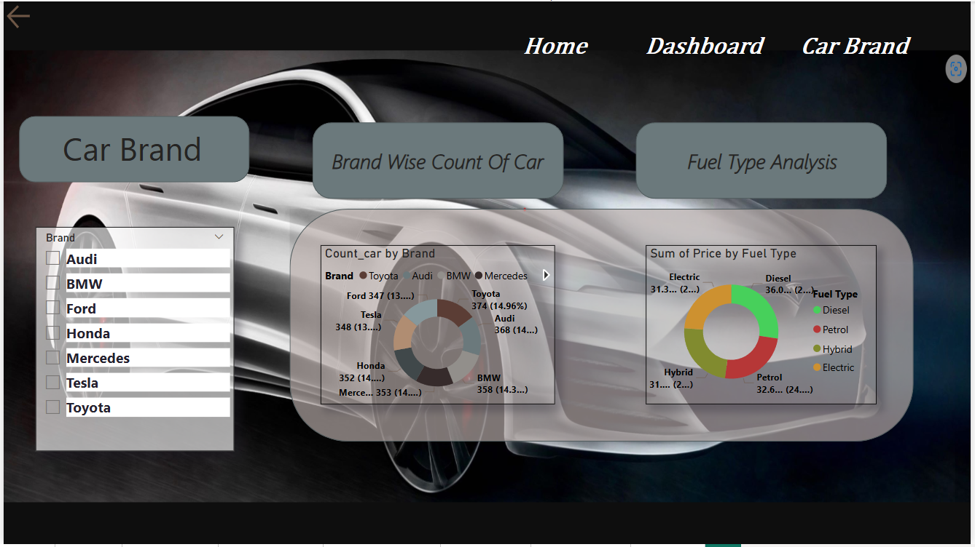
Dashboard 2

Slide 8
Insights
Total Car Price Overview:
The total price value displayed is 263.19M, with a partial focus on 131.60M, indicating a potential filter or segmentation in the analysis (likely by fuel type, e.g., Diesel).
Fuel Type Analysis:
Diesel vehicles dominate the market in price value at 26.31%, followed by Petrol (25.45%), Hybrid (24.64%), and Electric (23.6%).
This shows a relatively even distribution among fuel types, with Diesel slightly leading, possibly reflecting historical preferences or pricing dynamics.
Mileage vs. Condition:
Used cars have the highest mileage (44,862.6K), followed by Like New (44,741.7K) and New cars (41,990.7K).
The decreasing mileage trend aligns logically with vehicle condition, affirming data reliability.
Transmission-Based Analysis:
In Manual transmission, Tesla and Audi are top contributors, while in Automatic transmission, BMW and Mercedes lead.
Both transmission types have fairly distributed contributions across brands, suggesting consumer interest in both categories.
Brand Analysis (Price-Based):
The top contributing brands in terms of price:
Toyota (14.8%), BMW (14.73%), Audi (14.53%), Tesla (14.14%), and Mercedes (14.27%).
Ford (13.6%) and Honda (13.92%) have slightly lower shares.
This suggests a competitive market across these top brands.

Slide 9
Conclusion
Diesel vehicles lead in total price contribution (26.31%), but Petrol, Hybrid, and Electric vehicles follow closely, showing a balanced fuel type distribution.
Top contributing brands are Toyota (14.8%), BMW (14.73%), and Audi (14.53%), indicating these brands hold the highest market value.
Used cars dominate in total mileage, while new cars have the lowest, reflecting expected usage trends and strong market presence for pre-owned vehicles.

Slide 10
Thank you

